Slide 1

Impact of PM2.5 Pollution on China’s Economy: A Regression and Time Series Analysis Carried Out On 11 Chinese Provinces/Municipalities.
Submitted by: Sana Rabia Khan
MSc Student in Data Science and Statistics

Slide 2
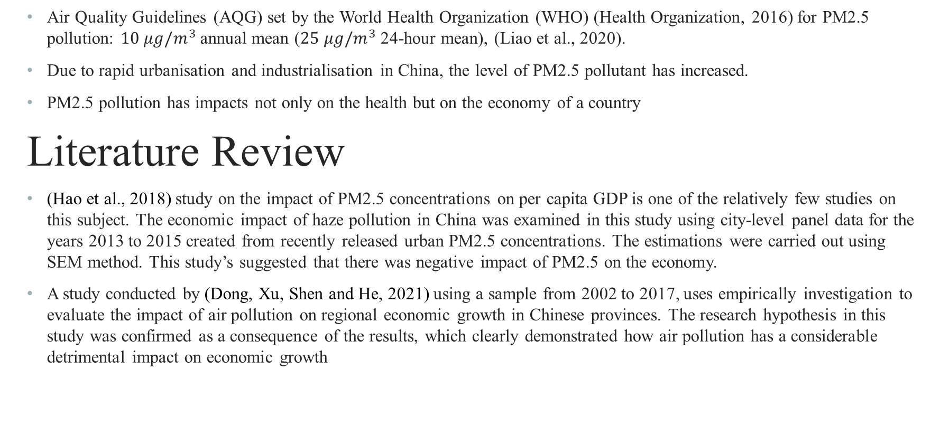
Introduction
Air Quality Guidelines (AQG) set by the World Health Organization (WHO) (Health Organization, 2016) for PM2.5 pollution: $10 μg/m^{3}$annual mean ($25 μg/m^{3}$ 24-hour mean), (Liao et al., 2020).
Due to rapid urbanisation and industrialisation in China, the level of PM2.5 pollutant has increased.
PM2.5 pollution has impacts not only on the health but on the economy of a country
Literature Review
(Hao et al., 2018) study on the impact of PM2.5 concentrations on per capita GDP is one of the relatively few studies on this subject. The economic impact of haze pollution in China was examined in this study using city-level panel data for the years 2013 to 2015 created from recently released urban PM2.5 concentrations. The estimations were carried out using SEM method. This study’s suggested that there was negative impact of PM2.5 on the economy.
A study conducted by (Dong, Xu, Shen and He, 2021) using a sample from 2002 to 2017, uses empirically investigation to evaluate the impact of air pollution on regional economic growth in Chinese provinces. The research hypothesis in this study was confirmed as a consequence of the results, which clearly demonstrated how air pollution has a considerable detrimental impact on economic growth

Slide 3
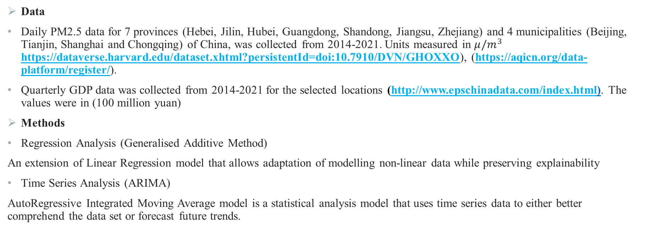
Data and Methods
Data
Daily PM2.5 data for 7 provinces (Hebei, Jilin, Hubei, Guangdong, Shandong, Jiangsu, Zhejiang) and 4 municipalities (Beijing, Tianjin, Shanghai and Chongqing) of China, was collected from 2014-2021. Units measured in $μ/m^{3}$ https://dataverse.harvard.edu/dataset.xhtml?persistentId=doi:10.7910/DVN/GHOXXO), (https://aqicn.org/data-platform/register/).
Quarterly GDP data was collected from 2014-2021 for the selected locations (http://www.epschinadata.com/index.html). The values were in (100 million yuan)
Methods
Regression Analysis (Generalised Additive Method)
An extension of Linear Regression model that allows adaptation of modelling non-linear data while preserving explainability
Time Series Analysis (ARIMA)
AutoRegressive Integrated Moving Average model is a statistical analysis model that uses time series data to either better comprehend the data set or forecast future trends.

Slide 4
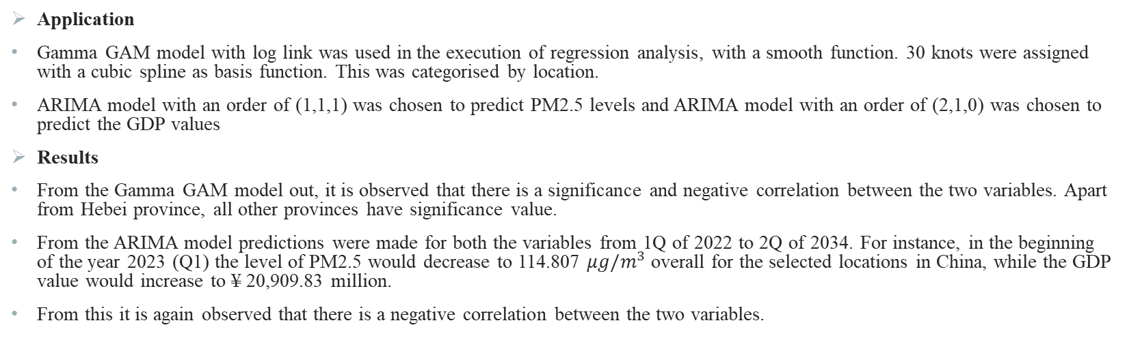
Application and Results
Application
Gamma GAM model with log link was used in the execution of regression analysis, with a smooth function. 30 knots were assigned with a cubic spline as basis function. This was categorised by location.
ARIMA model with an order of (1,1,1) was chosen to predict PM2.5 levels and ARIMA model with an order of (2,1,0) was chosen to predict the GDP values
Results
From the Gamma GAM model out, it is observed that there is a significance and negative correlation between the two variables. Apart from Hebei province, all other provinces have significance value.
From the ARIMA model predictions were made for both the variables from 1Q of 2022 to 2Q of 2034. For instance, in the beginning of the year 2023 (Q1) the level of PM2.5 would decrease to 114.807 $μg/m^{3}$ overall for the selected locations in China, while the GDP value would increase to ¥ 20,909.83 million.
From this it is again observed that there is a negative correlation between the two variables.

Slide 5
Conclusion
Overall from the analysis done in this study it is observed that there is a significant relation between the PM2.5 and GDP. Which goes on to confirm that PM2.5 pollution does have an influence on the growth of the economy.
Another finding was that in the recent years there has been a decline in the PM2.5 level which showed an effect on the economy, as the GDP values have increased.
This could be the result of the various air pollution policies that the government of China has undertaken in the past couple of years.
The model prediction could have been improved if there were more variables to add to the GAM model in order to better explain the reason for the GDP fluctuation other than PM2.5 level.
Another way to expand the scope of the study would be to use the coordinates of the locations selected for this study and apply the spatio-temporal analysis.

